Slide 1
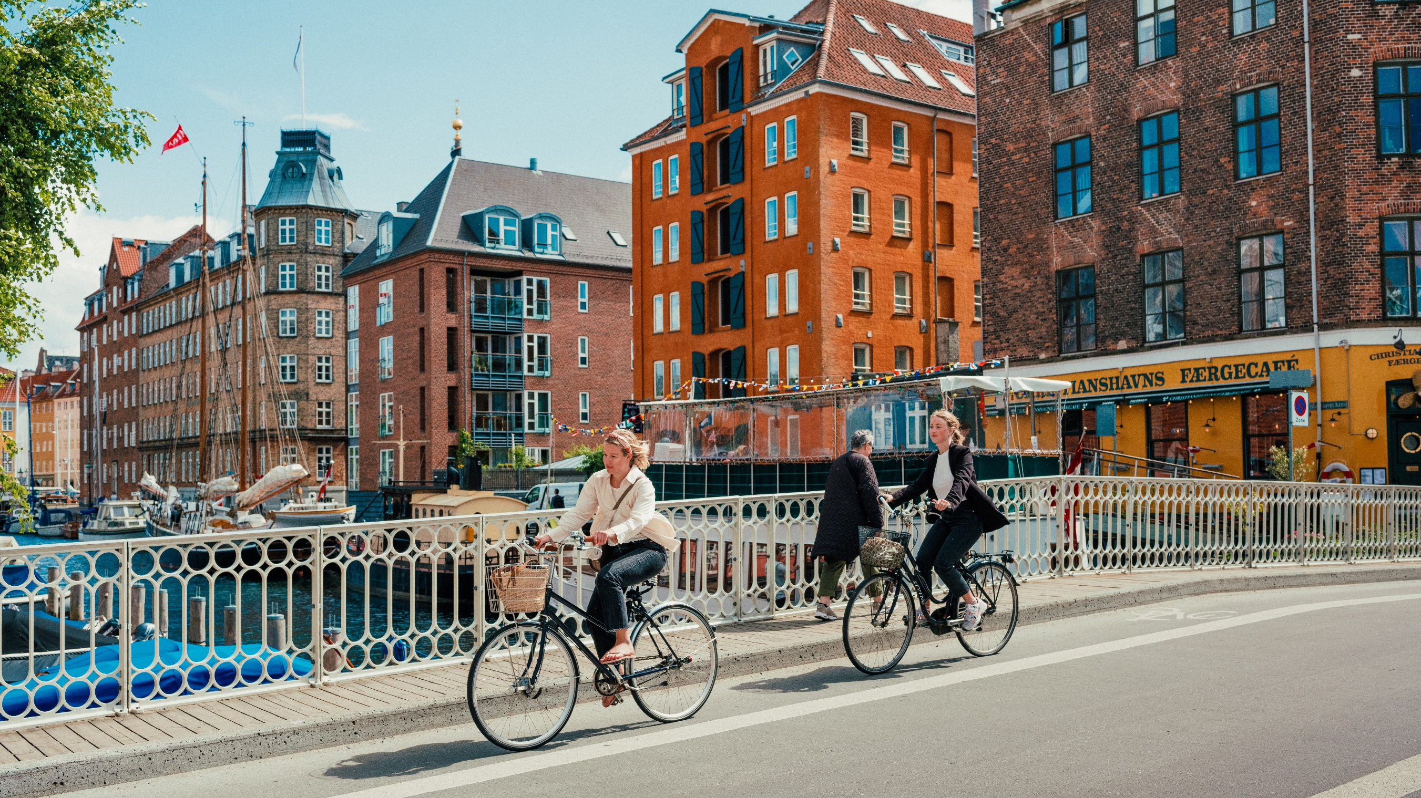
Zonta inTERDISTRICT SEMINAR 2025
COPENHAGEN
HOST CITY
Notes:
This is Copenhagen
Navn på forspørgsel/Kongres
Fed skrift tjek
Logoer

Slide 2
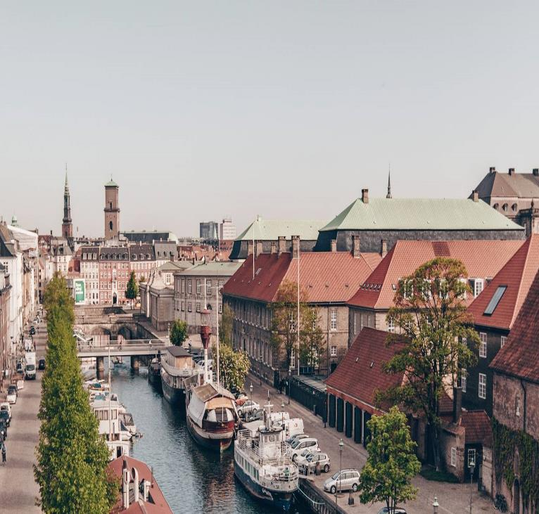
WHY COPENHAGEN?
Zonta’s European Interdistrict Seminar has never been in Denmark
One of the safest city in the world¹
One of the best cities in the world for quality of life²
One of the least corrupt destinations in the world (Transparency International)
Experienced and popular congress city with a professional approach and assistance
International airport with many direct flights, frequent trains/metro to the city center, short distances and good infrastructure
English-speaking population
Green frontrunner - sustainable focus in everything
History, innovative design, shopping and architecture
¹ Economist Intelligence Unit, 2021
² Monocle, 2021

Slide 3
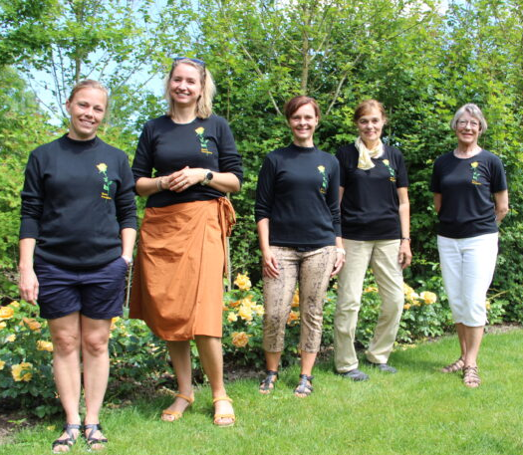
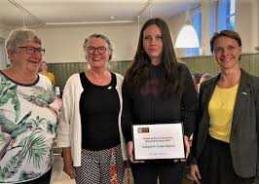
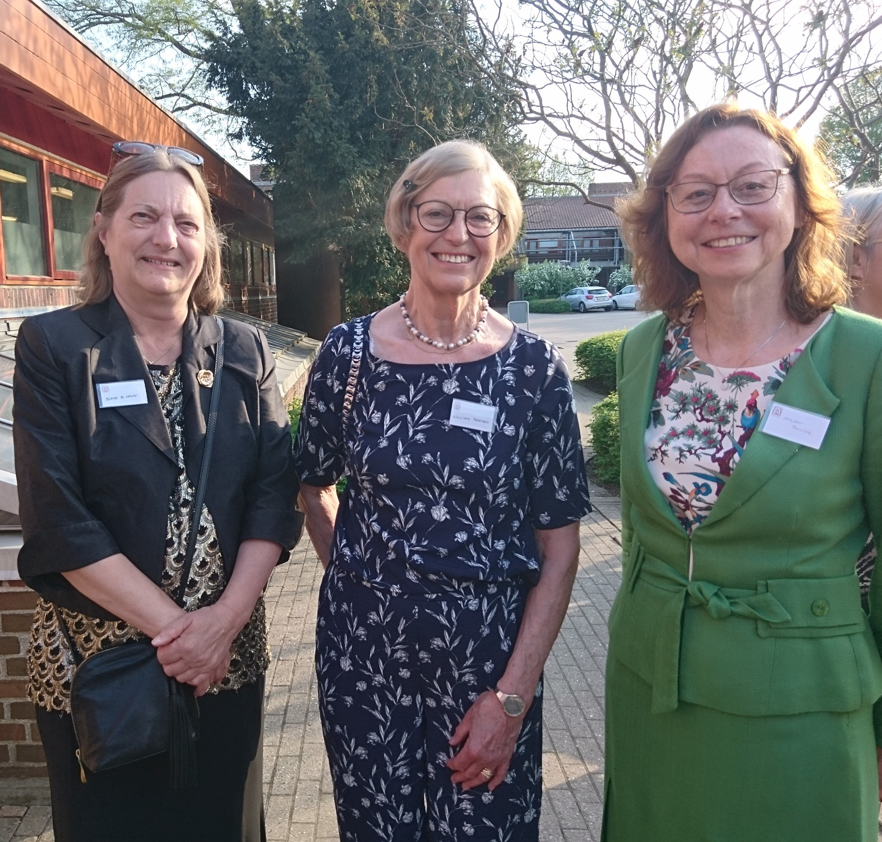
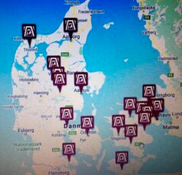
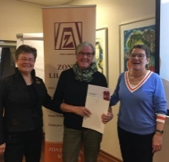
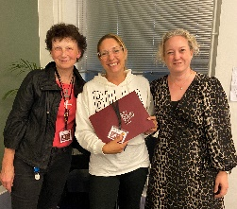
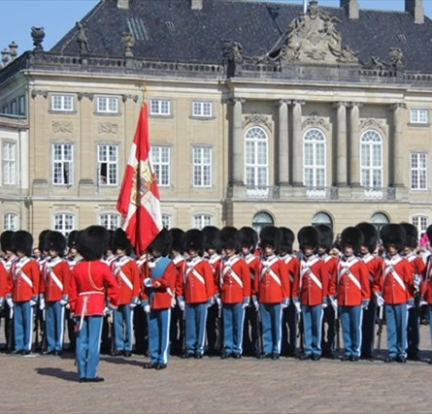
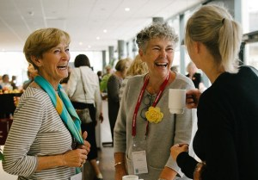
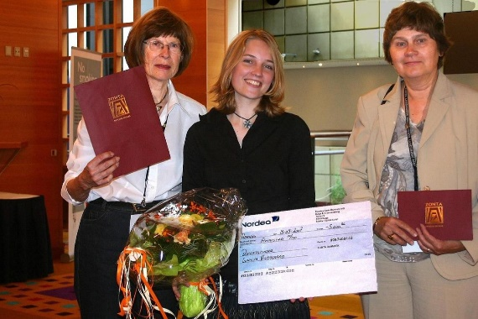
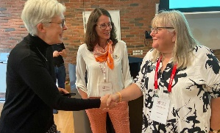
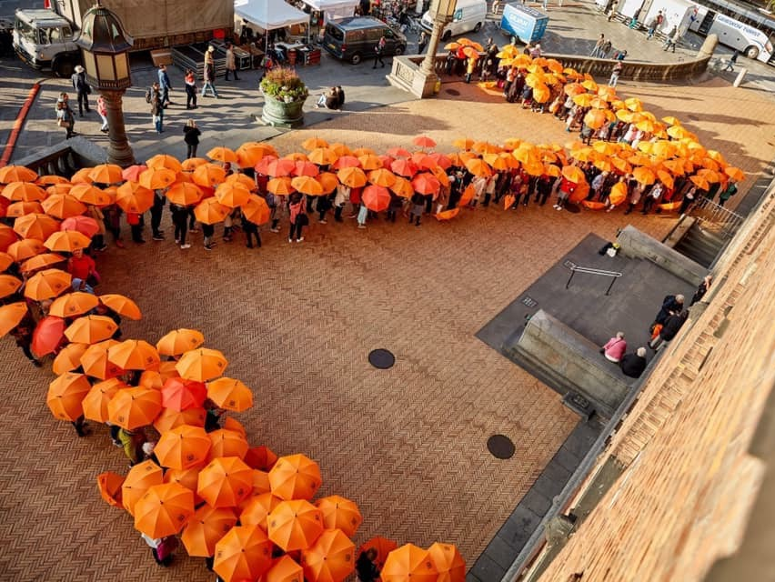
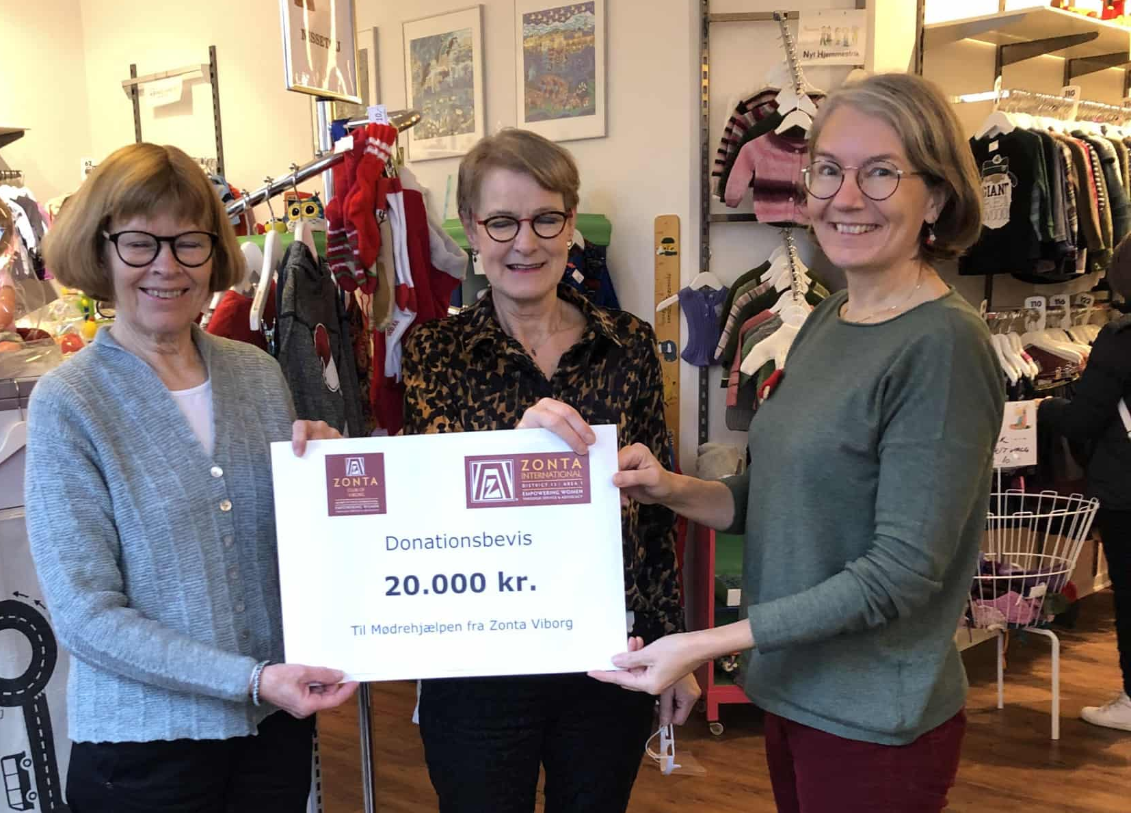
SUPPORT FROM 18 LOCAL CLUBS

Slide 4
theme
Support from all 4 countries in D13
Standing up for diversity, equity & inclusion
Chair:
PIP Maria Jose Landeira Oestergaard
Steering committee
COUNTRY | NAME
Denmark | Susanne Søndergaard Hansen
Lithuania | Ruta Jasioniene
Iceland | Ragna Karlsdottir
Norway | Heddy Tangen Steffensen

Slide 5
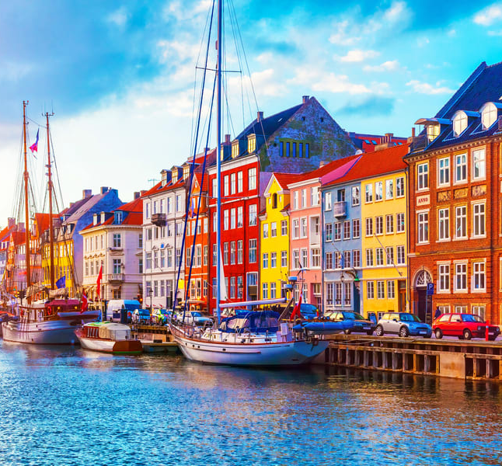
COMPLIMENTARY ASSISTANCE FROM wonderful Copenhagen (LINK)
Locates meeting facilities and hotels, reservations etc.
Adviser on financing
Has contact with the official Copenhagen
Has contact with any other relevant business partners
Assists with guide to tools for working with sustainability (Copenhagen Sustainability Guide)
Sets up and facilitates work with legacy (Copenhagen Legacy Lab)
www.Copenhagencvb.com

Slide 6
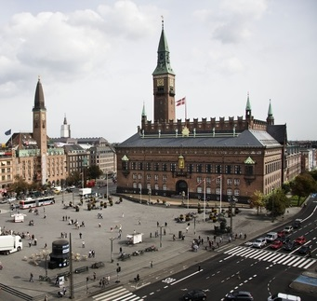
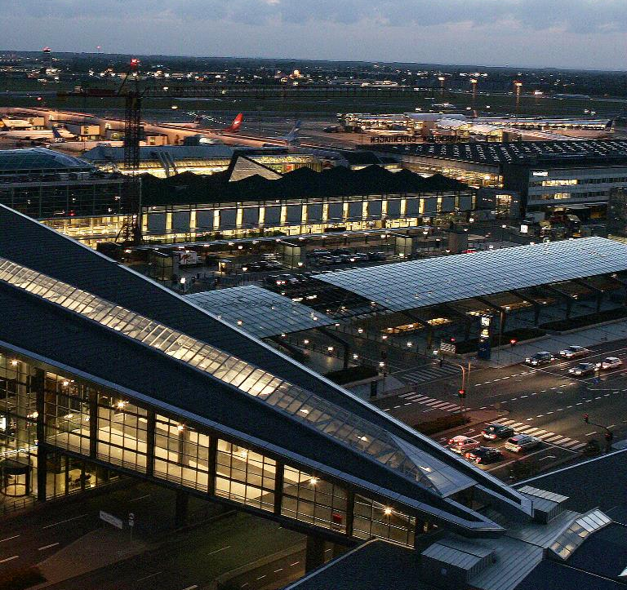
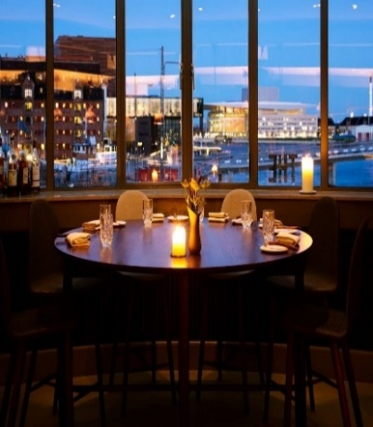
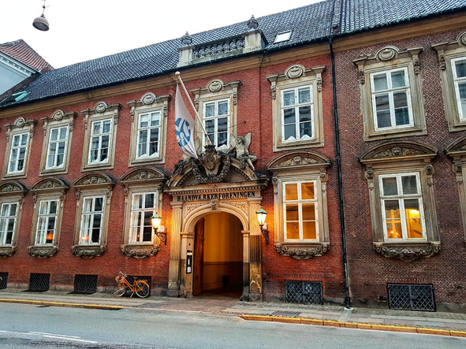
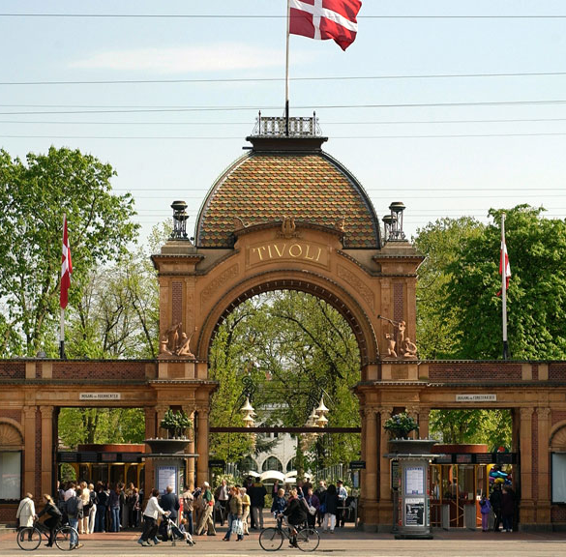
Multiple hotels & venues for events
Hotels in all price levels
Easy to get around
Copenhagen City Hall
Tivoli gardens
Museums
Palaces

Slide 7
www.Copenhagencvb.com

