Slide 1
Zonta Mentoring Initiative – Women for Women W4W
Zonta International District 28
25.09.2021 online

Slide 2
Why Zonta D28 Mentoring?
Personal development of the mentee and the mentor
Contact to interesting young women – potential Zontians
Insight into the lifestyles and ambitions of young women – refreshment of Zonta club life
Increase awareness of Zonta
A district program allowes cross-national pairings

Slide 3
What is Mentoring?
Listening & Learning from each other
Support for personal and professional development targets
Trusted communication/discussion of personal questions
Enrichment, extension and usage of Networks
Move forward together & have fun!!!!

Slide 4
D28 Mentoring approaches
Re-ignite “Godmother Concept” within ZONTA Clubs
Roll-out a ZONTA Mentoring program “Women for Women W4W”

Slide 5
1. Re-ignite “Godmother Concept”
Define pairings within clubs
For new joiners, for long-time Zontians
Nurture ZONTA internal and personal development
Use the available Leadership Development material on the ZONTA web-site
Use the available checklist for Zonta Godmothers
In case of questions contact the D28 Mentoring Coordinators

Slide 6
„I want (to be) a ZONTA Godmother“
Talk to your Club-President for an in-club 1:1 member connection or reach out to any other (new) Zontian pro-actively
Review the available Leadership Development material on the ZONTA web-site
Review the available checklist for Zonta Godmothers
In case of questions contact the D28 Mentoring Coordinators at W4WZontaMentoring@gmx.net
Connect to your contact, meet up, pre-define your journey, start talking and see where the connect takes you for the benefit of you both!
Remember how so much experience & valuable LIFE & ZONTA knowledge you have to give and learn!

Slide 7
2. Roll-out ZONTA Mentoring program
Mentoring Coordination team with 1 single point of contact for each area in D28
Coordination of the Mentoring program
Recruiting of new Mentors & Mentees
Matching of pairings (cross Area if needed)
Communication with Mentors & Mentees
Setting up the website ZontaDistrict28/Mentoring
Setting up and managing an Evaluation & Feedback process
Team members
D28 / Area 02 – Meike Rieken, ZC Darmstadt
D28 / Area 03 – Elena Federici Ballini, ZC Milano Sant’ Ambrogio
D28 / Area 04 – Ursula M. Kostal, ZC Vaduz

Slide 8
„I want to be a Mentor“
Fill out the Mentor Template
Send the Template to the D28 Mentoring Coordinators at W4WZontaMentoring@gmx.net
While waiting for a Mentee Connection feedback
Review the available Leadership Development material on the ZONTA web-site
Review the Mentoring Session Guidelines (see Appendix)
In case of questions contact the D28 Mentoring Coordinators at W4WZontaMentoring@gmx.net
Remember how much experience & valuable LIFE & ZONTA knowledge you have to give and learn!
Connect to your Mentee, meet up, pre-define your journey (including the duration), start talking and see where the connect takes you for the benefit of you both!

Slide 9
„I want to be a Mentee“
Fill out the Mentee Template
Send the Template to the D28 Mentoring Coordinators at W4WZontaMentoring@gmx.net
While waiting for a Mentor Connection feedback
Define your mentoring goals as clearly as possible
Review the Mentoring Session Guidelines (see Appendix)
In case of questions contact the D28 Mentoring Coordinators at W4WZontaMentoring@gmx.net
Remember how so much there is to learn about LIFE from another Woman!
Connect to your Mentor, meet up, pre-define your journey, start talking and see where the connect takes you for the benefit of you both!

Slide 10
W4W Zonta Mentoring – Next Steps
Date | Action | Receivers | Notes
25.09.21 | Program Presentation | D28 Board & DC Attendees | Ask for first feedback
15.10.21 | Information Mail | Area Directors → Club | Ask for feedback, offer specific area meeting
30.10.21 | Website Online | All D28 Members | Presentation and all mentoring artefacts like templates, checklists and guidelines
30.10.21 | Reminder Mail | Area Directors | Ask for feedback, offer specific area/club meetings as required
Thereafter Monthly | Check on incoming mentee/mentor requests | Program Team Members | Perform Mentee/Mentor Matching, Program Feedback to District Board/Area Directors Evaluation Process

Slide 11
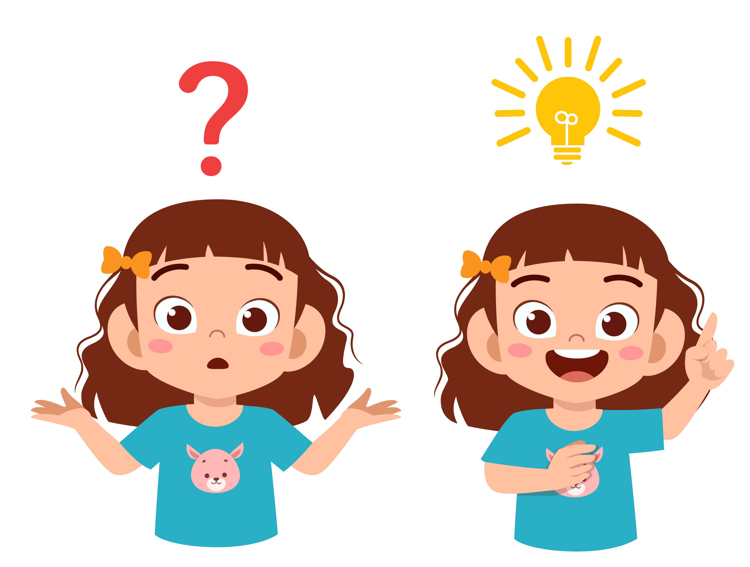
Questions and suggestions
Mail to W4WZontaMentoring@gmx.net

Slide 12
D28 Mentoring – W4W
Appendix

Slide 13
Mentoring Artefacts
Mail to W4WZontaMentoring@gmx.net
Mentoring Session Guidelines (see next slide)
Mentor and Mentee application templates
Checklist for “Godmother’s”
Welcome To Zonta
Mentor Template
Mentee Template

Slide 14
Mentoring Session Guidelines
1st Mentee – Mentor Connect after matching
Clarify mutual expectations
Define targets, content and frame work of the co-operation
E.g. Discussion topics/questions shared by email prior to each session - yes/no
Define frequency and nature/location
Recommendation is to connect once per month
E.g. phone, Online meeting, private house, restaurant/café for the sessions
Duration of collaboration
Recommendation is 12 months
Time and duration of the connect
Recommendation is 1-2 hrs per session
Regular Mentee – Mentor connect
Warming-up
How are you? New news? What happened since the last connect?
Discussion on the tasks/questions
Review of last connect - any trouble, if yes, which?
Celebrate successes together
Today‘s questions/concerns and target definitions – What? How?
Ways to overcome current obstacles
New target settings, new milestone definitions
Feedback and agreements for the next connect

